Slide 1

Credit Card Fraud Detection
Team Members:
Vardhana Bhatt
Anish Singh
Isha Madan
Neel Shah

Slide 2
Table of Contents
Problem Statement
Objective
Data Source
Related Work
Steps
Implementation
Conclusion
Future Scope
References

Slide 3
Problem Statement
Credit card has become the most popular mode of payment for both online as well as regular purchase.
As, the usage of credit cards has dramatically increased, cases of frauds have simultaneously increased too.
The Federal Trade Commission estimates that 10 million people are victimized by credit card theft each year.
It is important that credit card companies are able to detect transactions and differentiate between regular and fraudulent transactions so that customers are not charged with transactions that they did not do.

Slide 4
Objective
Credit Card Fraud problems can be tackled with Data Science. In This project, we intend to illustrate the modelling of data set using machine learning with credit fraud detection.
Imbalanced Data, that is ,most of the transactions are not fraudulent which makes it really hard for detecting the fraudulent ones.
Our objective here is to detect 100% of the fraudulent transactions while minimizing the incorrect fraud transactions.

Slide 5
Data Source
https://www.kaggle.com/mlg-ulb/creditcardfraud
The data contains 284,807 credit card transactions with 492 fraudulent.
Everything except the time and amount has been reduced by a Principle Component Analysis (PCA) for privacy concerns. Features V1, V2, ... V28 are the principal components obtained with PCA, the only features which have not been transformed with PCA are 'Time' and 'Amount'.
'Time' contains the seconds elapsed between each transaction.
'Amount' is the transaction Amount*
'Class' is the response variable and it takes value 1 in case of fraud and 0 otherwise

Slide 6
Related Work
Card Prediction using Machine Learning
There have been many attempts in predicting card fraud using various Machine Learning Algorithms. For example, Detecting fraudulent credit card transactions with supervised learning (2018) is able to accurately identify fraudulent transactions using a random forest mode
Analyze Types of Credit Card Frauds
For example, Credit Card Frauds in Banking (2014) explores the credit card fraud and methods of it, and gives information about what to do in case of encountering credit card fraud by chargeback topic.
Although many employ traditional Machine learning for fraud prediction and prevention – they do not address imbalance and sparsity of data.

Slide 7
Steps
Data Cleaning & Exploratory Data Analysis
Decision tree classifier
Random Forest Classifier
K-Means Clustering
DNN & DNN-Smote
Convolutional Neural Network
Comparison of Classifier accuracies and F1 score
Conclusion

Slide 8
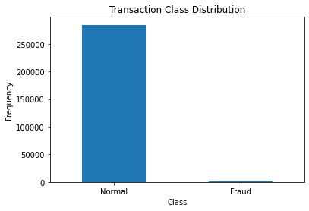
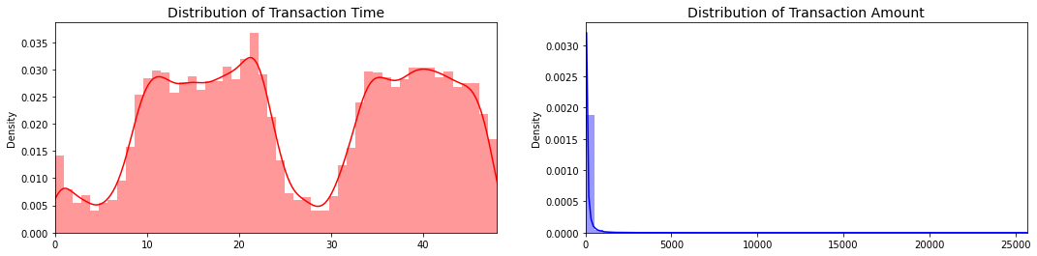
Data Cleaning & Exploratory Data Analysis
We checked the data initially and got the information about the dataset.
To perform data cleaning, we checked if the data has any null values.
The result we obtained was that the number of fraudulent cases are way too less compared to non-fraudulent cases.
We further analysed more information from the transactions and got the mean transaction value for both the cases
Lastly, we checked what time the fraudulent cases occurred the most and analysed how time and amount are related to each other.

Slide 9
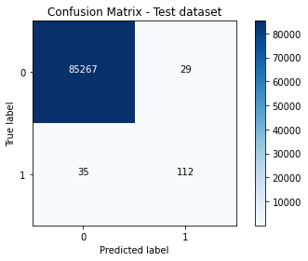
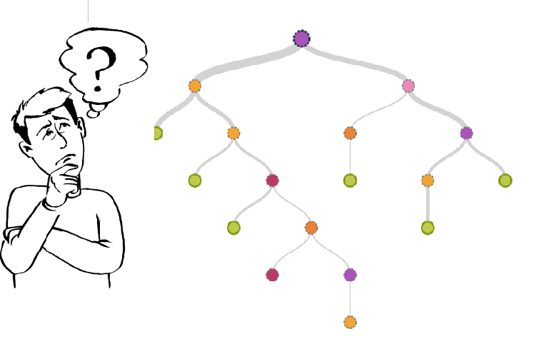
Decision Tree
The decision tree is the simplest and most popular classification algorithm. For building the model the decision tree algorithm considers all the provided features of the data and comes up with the important features.
Performed Hyperparameter Tuning for more accuracy

Slide 10
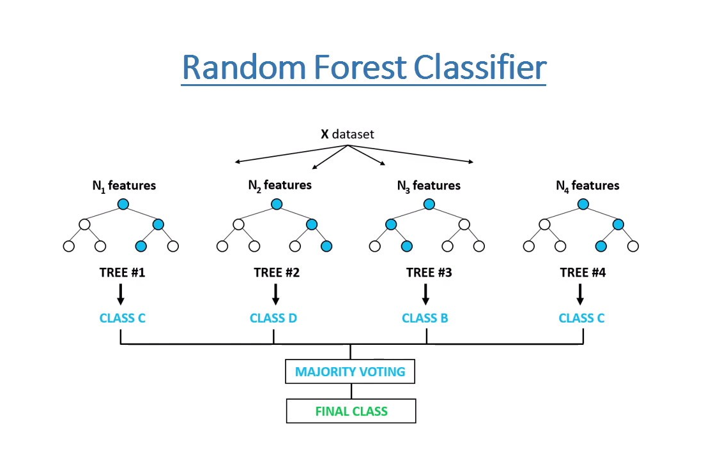
Random Forest
Random forest is a supervised learning algorithm. It builds multiple decision trees and merges them together to get a more accurate and stable prediction.
Demonstrated GridsearchCV algorithm for hyperparameter tuning for better results.

Slide 11
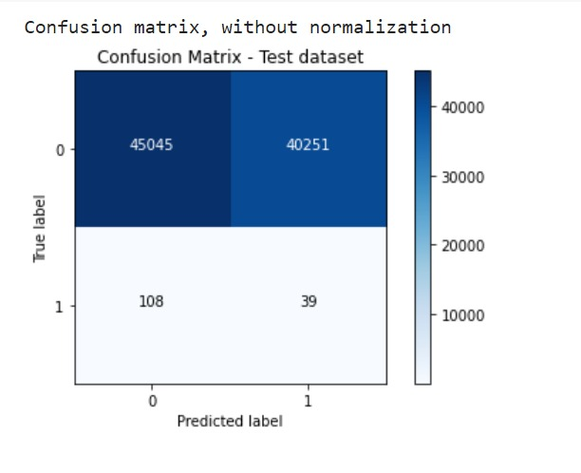
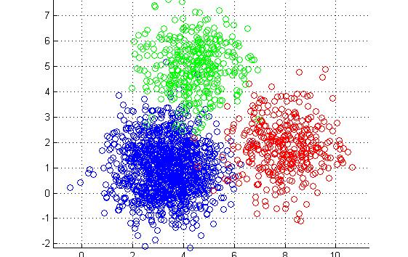
K-Means Clustering
K-means is an unsupervised learning technique, used for clustering. K-Means tries to determine new patterns from the data and by clustering the data into groups

Slide 12
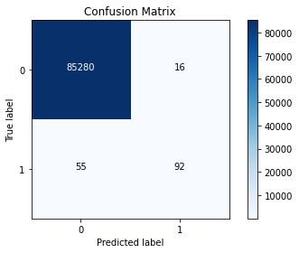
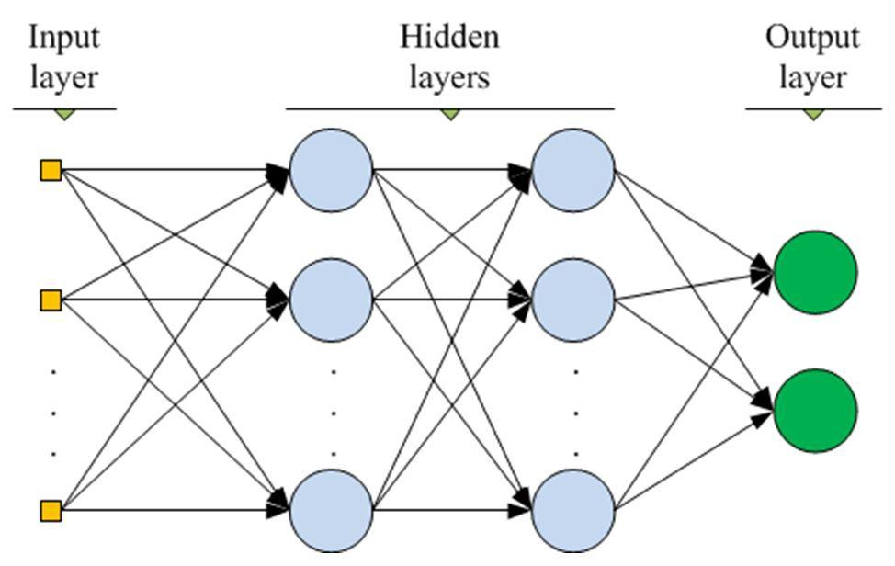
DNN
In deep-learning networks, each layer of nodes trains on a distinct set of features based on the previous layer’s output. The further you advance into the neural net, the more complex the features your nodes can recognize, since they aggregate and recombine features from the previous layer.

Slide 13
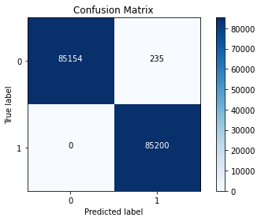
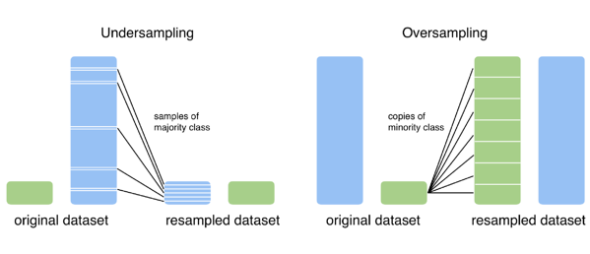
DNN with SMOTE
Synthetic Minority Over-sampling, or SMOTE for short can synthesize data from existing ones. SMOTE takes the entire dataset as an input, but it increases the percentage of only the minority cases.

Slide 14
Comparison of Classifier accuracies
ALGORITHM | PRECISION % | RECALL % | F1 %
Decision Tree | 79 | 76 | 77
Random Forest | 95 | 78 | 77
K-Means | 64 | 17 | 53
DNN | 85 | 62 | 72
DNN with SMOTE | 99 | 99 | 99

Slide 15
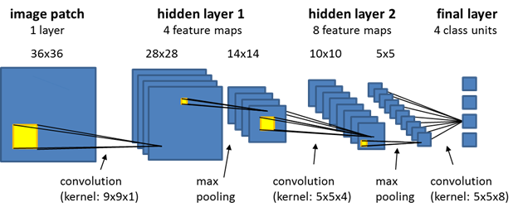
Convolutional Neural Network
CNN are used for Image Data Analysis. However, we wanted to go an extra mile and explore how CNN works for our Data Set.
We have hyperparameter tuning for CCN:
Added Dropout layer (Dropout() is used to randomly set the outgoing edges of hidden units to 0 at each update of the training phase.)
MaxPool layer
increase the number of epochs to improve our accuracy

Slide 16
Conclusion
In this project, we investigated whether resampling technique can bring improvement to model of imbalanced classification and have used multiple models and based on their accuracy we have found the most appropriate model for our dataset.
Out of Decision Tree, Random Forest, K-means, DNN, and DNN with SMOTE,
SMOTE shows the best result with accuracy, precision and F1 of 99%
We also explored the possibility of using Convolutional Neural network in our project to get better results.

Slide 17
Future Scope
This project can achieve versatility and modularity if we can add more algorithms to the model. However, all algorithms should have same format. With that condition, the modules can be easily added as done in the code.
A large dataset will help increase the precision of the algorithms. Hence, More the data, more the fraud detection and it will reduce the number of false positives. However, this process will require official assistance from the banks themselves.
If we can manage to get 100 % precision, a perfect classifier will help create a model that will help lot of banks and companies in detecting fraudulent cases in quick time.

Slide 18
References
https://www.researchgate.net/publication/2948052_KNN_Model-Based_Approach_in_Classification
https://www.researchgate.net/publication/236952762_Random_Forests
https://keras.io/api/layers/core_layers/dense/
https://stanford.edu/~cpiech/cs221/handouts/kmeans.html
https://machinelearningmastery.com/smote-oversampling-for-imbalanced-classification/

Slide 19


